Slide 1
IEEE-CIS Fraud Detection
Can you detect fraud from customer transactions?
Fang Feng

Slide 2
Context
This project is one of the Kaggle competition, IEEE Fraud Detection competition, seeking the best solutions for fraud prevention industry.
The data comes from Vesta (world’s leading payment service company, Vesta Corporation) 's real-world e-commerce transactions
Data Description
104MB 2 data sets
600,000 rows and 459 columns
To improve the efficacy of fraudulent transaction alerts for millions of people around the world, helping hundreds of thousands of businesses reduce their fraud loss and increase their revenue.
Foot note: https://www.creditdonkey.com/credit-card-fraud-statistics.html

Slide 3
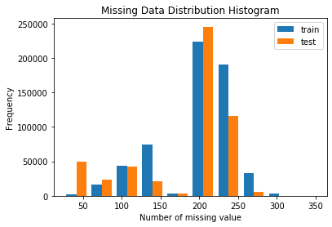
Interesting finding
Unusual data sets which have many missing data and many missing information for each column
identity of the customer and transaction information
Feature engineering
count missing information as a new feature
Model selection
Light GBM: It can handle NaN values out of the box and more effective

Slide 4
Insight
It seems that train and test transaction dates don't overlap, so it would be prudent to use time-based split for validation
And the fraudulent transaction amount seems smaller then the real transaction amount

Slide 5
Next steps
Feature
Feature engineering with as many features as possible
Using TransactionDT (timedelta from a given reference datetime), Product type and transaction amount
Model Blending
Blend with XGboost

Slide 6
Thank you for your attention!

